Slide 1
Caliptra and FIPS 140-3 CMVP
Oct 2025 Update

Slide 2
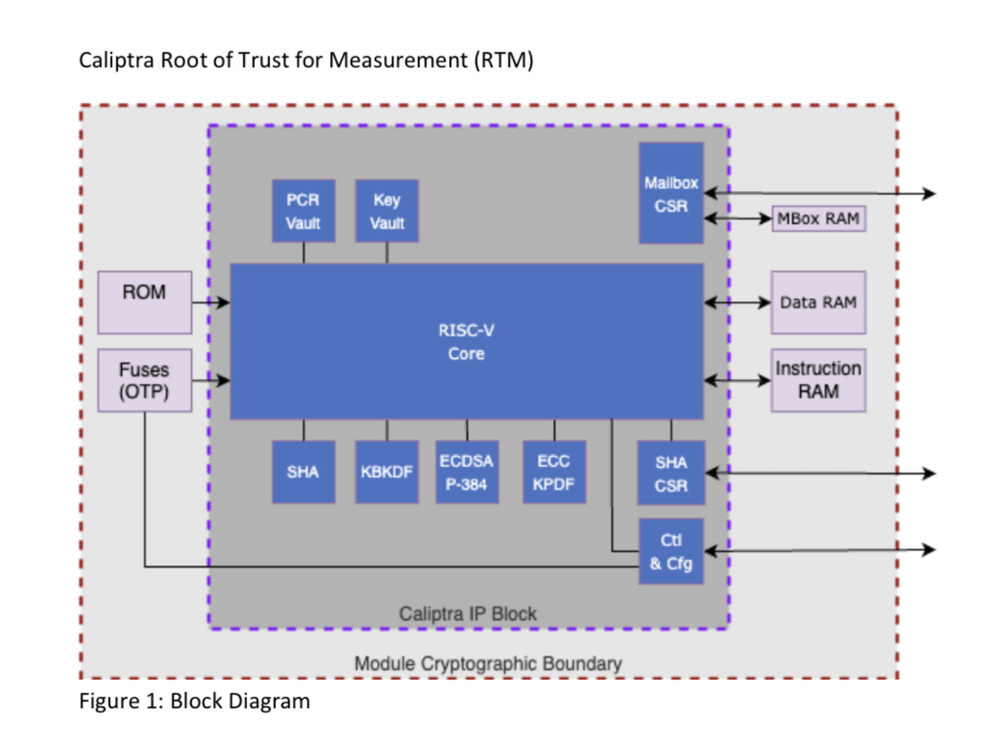
Agenda
Caliptra CMVP Strategies
Caliptra 1.X CMVP
Caliptra 2.X CMVP
Caliptra 2.X Sub-System CMVP
Higher-Level FIPS Certifications
Questions

Slide 3
Multiple Strategies for Caliptra CMVP
Caliptra CMVP Only
Best when Caliptra is the only Crypto in the SOC
Hardware-Subchip Module
Caliptra and SOC ROT CMVP
Best when SOC Mgr has a simple interface or more crypto needs to be added to CMVP
Hardware-Subchip Module
Product CMVP Certification
Best when product interfaces are simple (entire PCIe Card)
Multiple Chip
Increasing Module Complexity

Slide 4
Smallest Module Boundary Definition
Caliptra IP and Caliptra Wrapper within the sub-chip boundary
Fuses need to be zeroizable
Fuses and RAM need to be isolated
Example Security Policy Provided by Caliptra WG based on this module definition

Slide 5
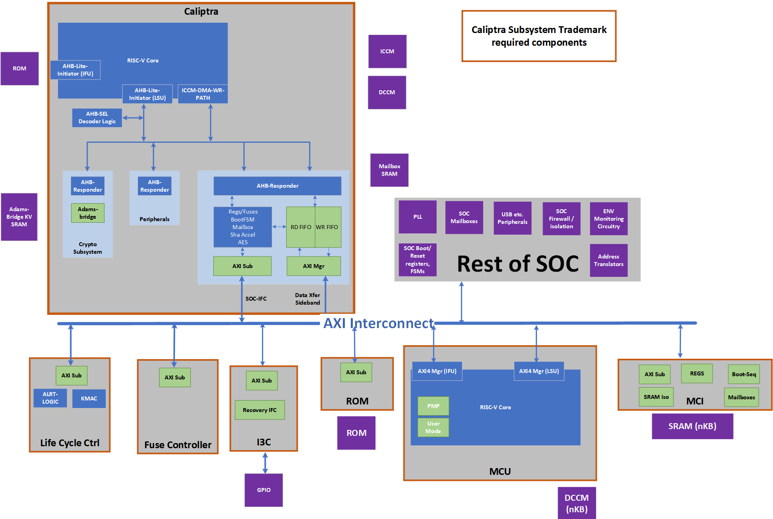
Caliptra and SOC ROT Module Boundary
Caliptra interfaces are managed by the ROT
Caliptra Errors/Self-test are managed by the ROT
Authentication can be provided by ROT
Higher levels can be achieved depending on FW in the ROT (interface definitions)
Work with your lab to define this boundary

Slide 6
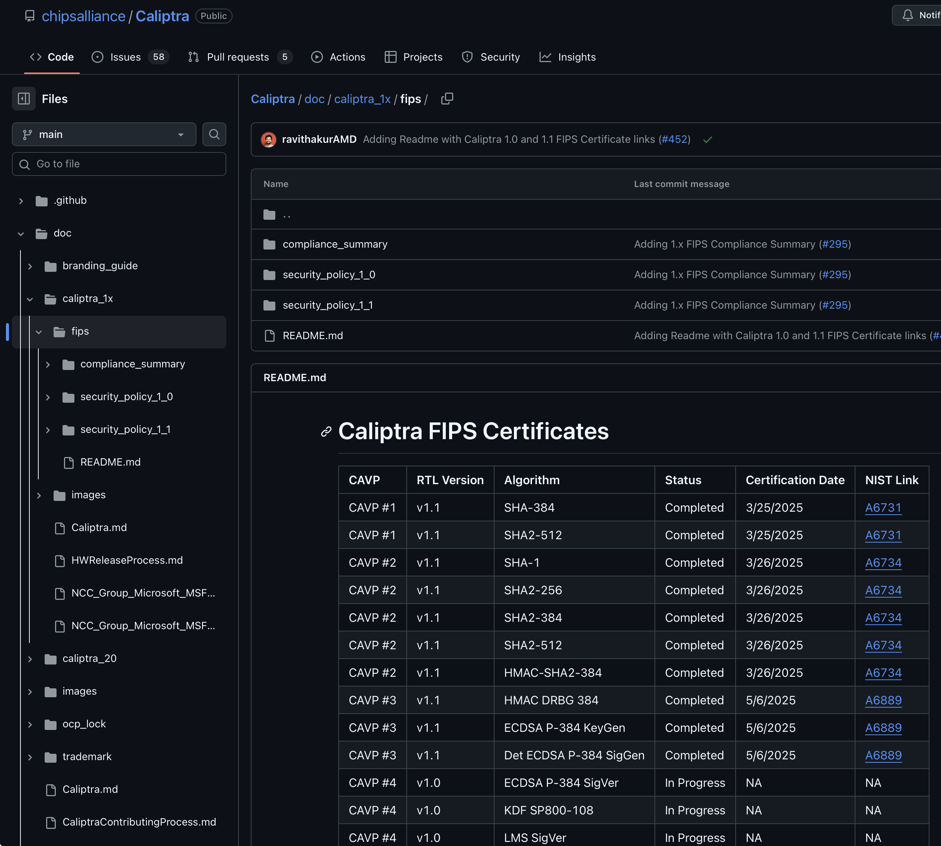
Caliptra 1.X CMVP
Targeted 140-3 Level 1
Have your lab be part of the process from the beginning
Decisions in your Caliptra Wrapper will affect your CMVP
Caliptra 1.X DICE Submitted to NIST Crypto Tech Group
Caliptra 1.X CAVP is ready
CAVP Certificates (could be used for CMVP)
Functional Test Suite is Ready
ESV not required

Slide 7
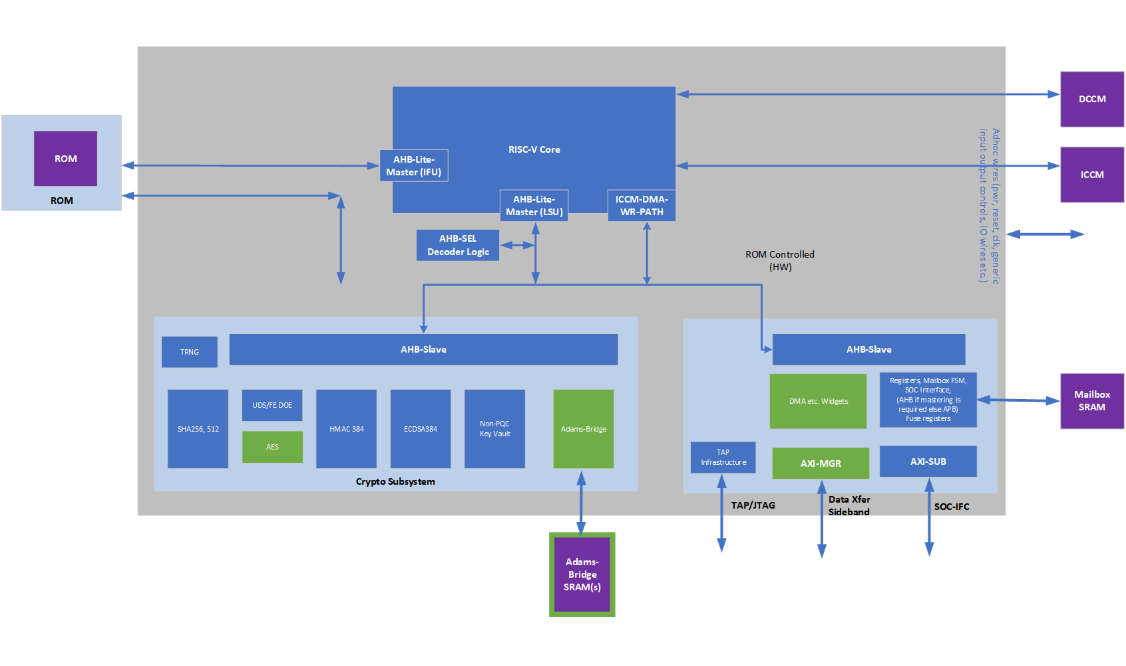
Caliptra 2.X CMVP – What to expect from WG
Updated Security Policy Template for Caliptra 2.X in progress
CAVP for new algorithms coming
AES
ML-DSA/ML-KEM
Updated Functional Tests
Submit any concerns/questions within the Caliptra Repo

Slide 8
Caliptra 2.X Sub-System CMVP Review
Review of Caliptra Sub-System in progress to ensure certifiability
Caliptra WG can only look at this from the smallest module strategy
ETA 12/30/25 for more details on certifiability

Slide 9
Higher-Level FIPS Module
We are working with CMUF to help define a path to achieve Level 3
Level 3 typically requires encryption of all data entering/leaving the module
Level 3 CMVP Identity Based Authentication is difficult in sub-chip
Plain-Text Trusted Path Definition in progress
Higher Levels require work outside Caliptra
Environmental Monitoring
Physical Tamper Evidence
Authentication
Caliptra is working towards level 3 readiness
Periodic Self Tests
MCU/User Signature-based Authentication
Measurement Manifest Authentication
Engage with your lab early if you intend for a higher level module

Slide 10
Questions
Please submit issues/concerns to Caliptra Repo

