Slide 1

Caliptra Workshop Device Ownership Transfer
James Zhang (NVIDIA) Christopher Swenson (Microsoft)

Slide 2


Caliptra Workshop Device Ownership Transfer
Security
James Zhang (NVIDIA) Christopher Swenson (Microsoft)

Slide 3
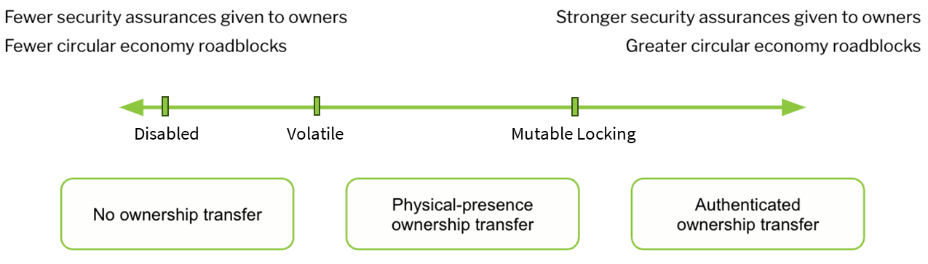
Refresh - What is Device Ownership Transfer?
Ability for owner of the system to assert ownership through code signing
Ability for ownership to be transferred without cumbersome process and handshake
OCP Device Ownership Transfer defines the general Archetypes, State Transition and Protocol for Device Ownership Transfer
Volatile Ownership Transfer
Mutable Locking Ownership Transfer

Slide 4
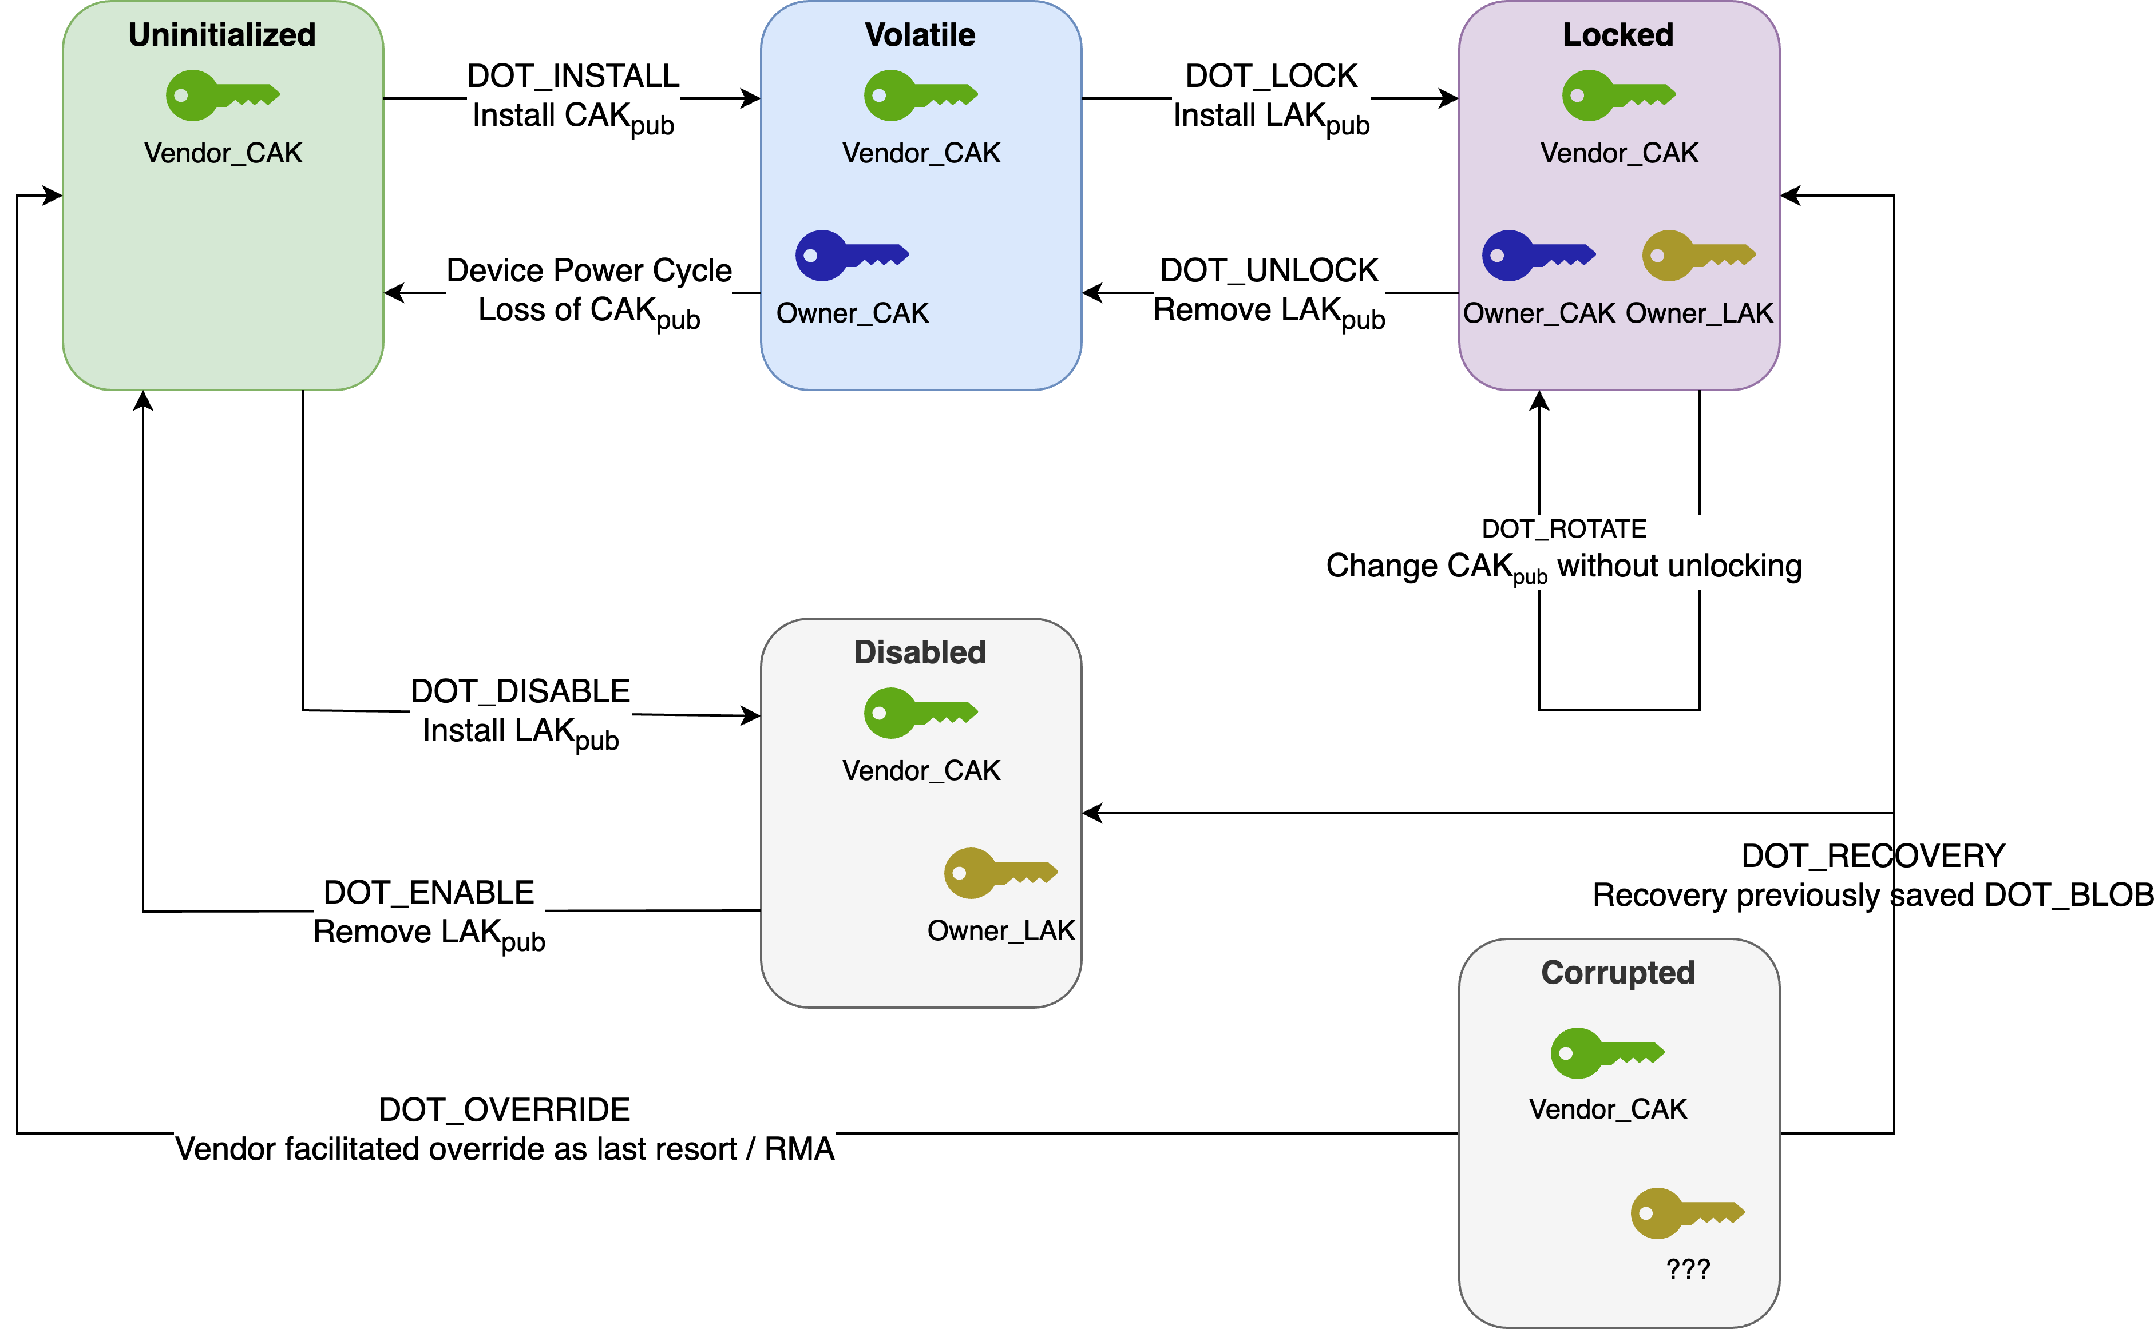
Updated - Ownership Transfer State Transitions

Slide 5
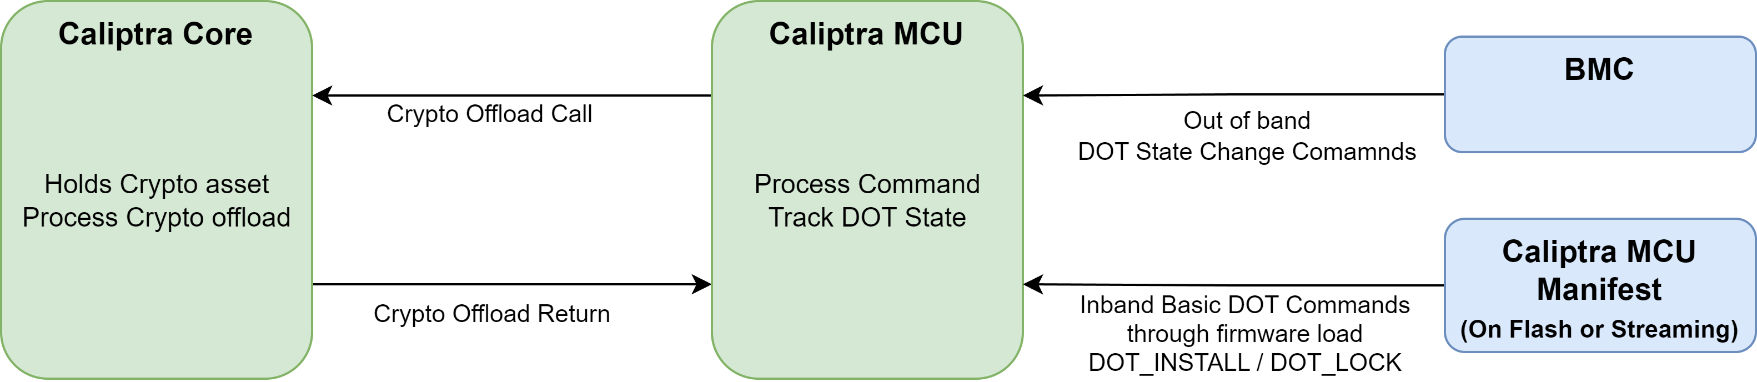
Caliptra – How Does Caliptra Adapt DOT?
Caliptra Core manages crypto asset and offer crypto offload capabilities
Caliptra MCU manages command protocol for state transitions. Offload crypto calls to Core.
BMC send out of band command to Caliptra MCU to manipulate DOT State Change
Caliptra MCU Manifest can also be used to conduct basic (DOT_INSTALL / DOT_LOCK) operations in-band for ease of datacenter management.

Slide 6
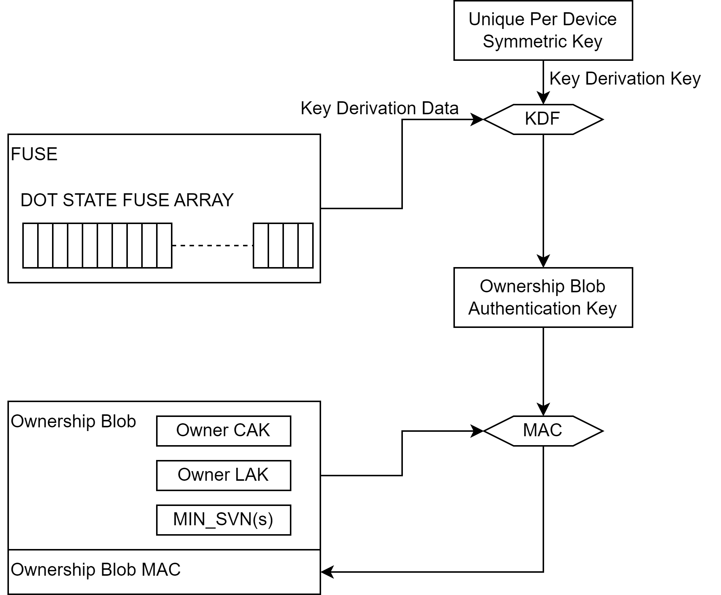
Persistent State – Dealing with Lock
Secure Storage needed for storage of ownership data for Mutable Locking DOT
Not all silicon have tightly coupled Secure Storage Solution (In Silicon Flash/In Package Flash/etc)
Solution – Cryptographic binding of ownership data (Oct 16th OCP Security Track 9:10 Session goes into more detail)
1 FUSE bit used per mutable locked state transition (Owned -> Unowned, Unowned -> Owned)
EVEN number of Fuse bit burned -> Device has no locked ownership
ODD number of FUSE bit burned -> Device has locked ownership
Unique Per Device key used to ensure no DOT Blob re-use on different device
Forward fuse burning ensures no replay attack

Slide 7
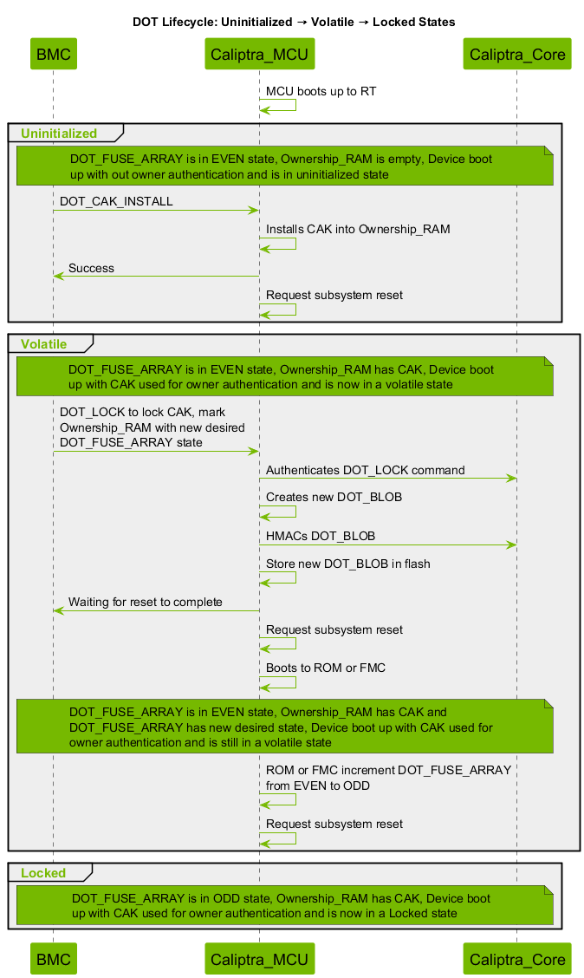
Caliptra DOT – Install and Lock
DOT_INSTALL installs volatile ownership
Volatile Ownership is kept in Ownership RAM
Scratch register that persists across low level reset, cleared on power cycle
Ownership RAM is defined by SOC integrator of Caliptra MCU
Volatile Ownership is lost on power cycle
DOT_LOCK would lock installed Ownership into secure storage. DOT State transition to Mutable Locking (Locked State) through FUSE increment to ODD.

Slide 8
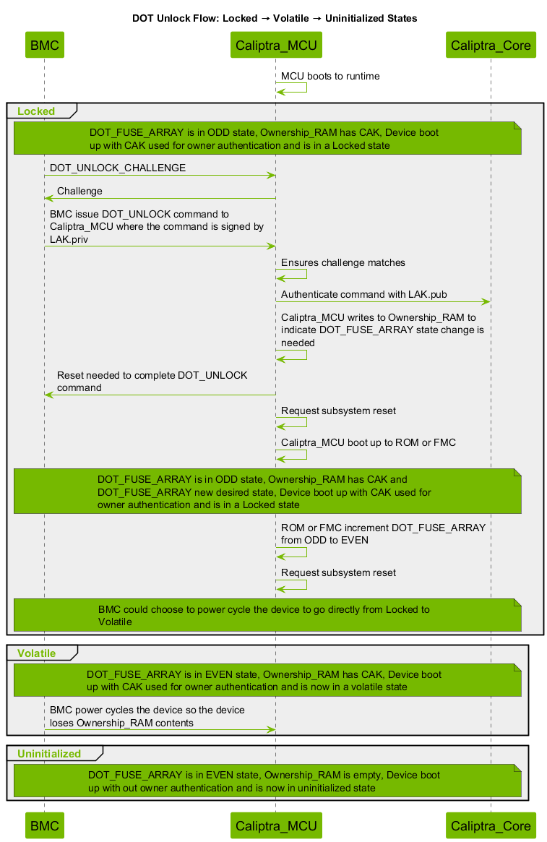
Caliptra DOT – Unlock and Reset
DOT_UNLOCK_CHALLENGE / DOT_UNLOCK to unlock Mutable Locking DOT.
Secure storage updated to reflect. Fuse increment back to EVEN.
Power cycle to lose even volatile ownership

Slide 9
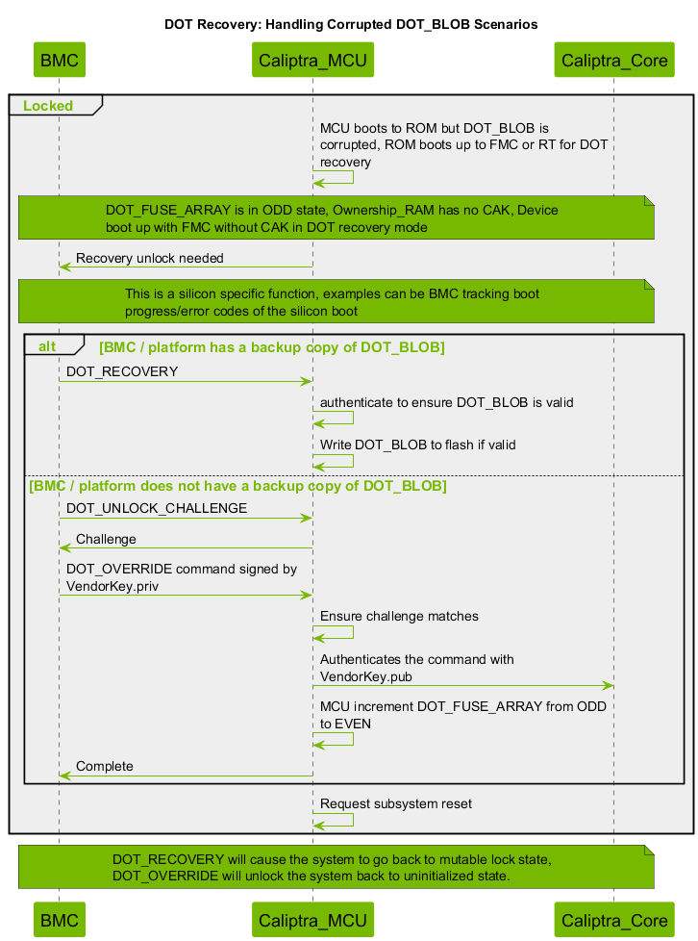
Caliptra DOT – BLOB Missing
DOT_RECOVERY used if back up blob is available
DOT_OVERRIDE as RMA use case for vendor to unlock a locked part

Slide 10
Status
Caliptra DOT Spec near finalize
OCP DOT Spec is being updated to use Caliptra implementation as example
Caliptra Core 2.1 release include all ROM / HW function needed for Crypto Offload
Caliptra MCU DOT Implementation on goin, will be available in 2.x SDK (undecided)
Questions?

Slide 11
Thank You!

Slide 12
Open Discussion
You have two options for a closing slide:
“Open Discussion” (this slide)
–OR–
“Thank You” (previous slide)
Please choose one.
Please remove all yellow notes before submitting your presentation.
Click here to review OCP Trademark Guidelines

Slide 13






Please use the appropriate Global Track name and icon.
COOLING ENVIRONMENTS: IMMERSION
COOLING ENVIRONMENTS & LIQUID COOLING
DATA CENTER FACILITY (DCF)
DIGITAL TWINS
EDGE
HARDWARE MANAGEMENT

Slide 14




Please use the appropriate Global Track name and icon.
NETWORKING
OPEN PLATFORM FIRMWARE (OPF)
RACK & POWER
SECURITY
SERVER: AI HW SW CO-DESIGN/NIC/HPC
SERVER: COMPOSABLE MEMORY SYSTEMS (CMS)

Slide 15






Please use the appropriate Global Track name and icon.
SERVER: MODULAR HARDWARE SYSTEM (MHS)
SERVER: OPEN CHIPLET ECONOMY
STORAGE
SUSTAINABILITY
TEST & VALIDATION
TIME APPLIANCES (TAP)

Slide 16




Please use the appropriate Global Track name and icon.
OCP SPECIAL FOCUS: ARTIFICIAL INTELLIGENCE (AI)
OCP SPECIAL FOCUS: MARKET IMPACT & OCP ADOPTION STORIES
OCP SPECIAL FOCUS: OPENRAN
OCP SPECIAL FOCUS: PHOTONICS

Slide 17




Please use one of these membership logos to designate your company’s membership level.

Slide 18







Please use one of these logos if your facility is an OCP Ready™ facility or you’re hosting an Experience Center.
Please use this logo if your product has been approved through the OCP S.A.F.E. program.
Please use one of these logos if your product has been recognized as OCP AcceptedTM or OCP InspiredTM
Please use this logo if you are hosting an area in the Innovation Village.
Please use this logo if you are an
OCP Solution Provider.

Slide 19






Please use the appropriate icon representing the Regional Project Group.

