Slide 1
OCP Caliptra Workshop: Attestation Architecture
Fabrizio D’Amato (AMD)
Jeff Andersen (Google)

Slide 2
Device Attestation with Caliptra
Agenda:
Attestations Framework and Caliptra Role
How DICE, DPE, SPDM , CoRIM work together
RATS Architecture and claim mapping

Slide 3




Attestation Framework
CoRIM = Concise Reference Integrity Manifest
SFR = Short Form Report
Device Vendor
CoRIM
(ref val)
CoRIM (SFR)
3rd Party Auditors
Reference Value Provider
Reference Values
Endorsements
Endorser
TCBInfo
(DICE/
DPE)
Caliptra Integrated Device
Attester
Evidence
Verifier
OCP EAT
EAR
End Customer
Appraisal Results
Relying Party
EAT = Entity Attestation Token
EAR = EAT Attestation Result

Slide 4
Identity vs Inventory Attestation
Identity Attestation (DICE + DPE):
Purpose: "Who am I and am I authentic?"
Proves: Device/component identity and integrity
Mechanism: Certificate chains with measurements
Example: "I am legitimate SPDM Responder"
Inventory Attestation (SPDM):
Purpose: "What components are installed?"
Reports: Complete system inventory
Mechanism: Enumeration + measurement collection
Example: "I contain: Bootloader, OS, APP XYZ"
Identity (DICE+DPE) proves the inventory reporter is authentic
↓
Inventory (SPDM) can be trusted because reporter is verified

Slide 5
DICE VS DPE
Caliptra RoT FW Attestation - DICE
Purpose: “is Caliptra running trusted firmware?”
Proves: Caliptra booted with Authentic firmware and secure fuse settings
Mechanism: Certificate chains with measurements
Example: "I am legitimate Caliptra firmware "
Inventory Application Attestation - DPE
Purpose: “is the SPDM Responder Authentic ?”
Proves: integrity of the Attester Application
Mechanism: Certificate chains with measurements
Example: "I am legitimate SPDM Responder "
DICE proves that Caliptra is running authentic firmware and fuse configuration
↓
DPE can be trusted to attest to the SPDM Responder

Slide 6
Attester Composition
Definition from Remote ATtestation ProcedureS (RATS)
Device Attester
An Attester is composed of:
Multiple Target Environments, components like firmware and HW configs.
Single Attesting Environment, which:
Collects Target Environments claims
Signs evidence
Target Environment Claims:
Identification (Environment Map)
Uniquely Identifiable by triple: Vendor, Model, and ClassID
- Properties (Measurement Map)
Digest, SVN, FWVersion, Flags, etc
Attesting Environment
Target
Env 0
Target
Env 1
Target
Env 2
{
Vendor
Model
ClassID
}
{
Digest
SVN
…
}
{
Vendor
Model
ClassID
}
{
Digest
SVN
…
}
{
Vendor
Model
ClassID
}
{
Digest
SVN
…
}
Environment Map
Measurement Map
Notes:
This slide explains the structure of attestation environments, focusing on the role of Caliptra as the attesting environment that collects and signs data from various target components. It highlights the importance of Target Environments being measurable parts such as firmware or hardware configurations. The universal identification triple ensures consistency across different attestation artifacts, facilitating automated verification.

Slide 7
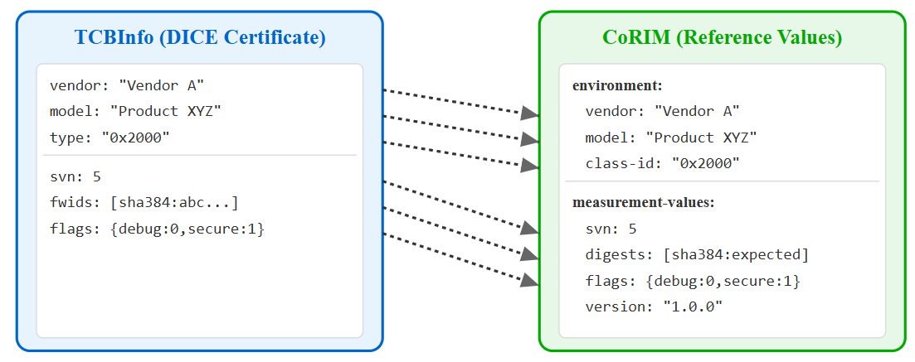
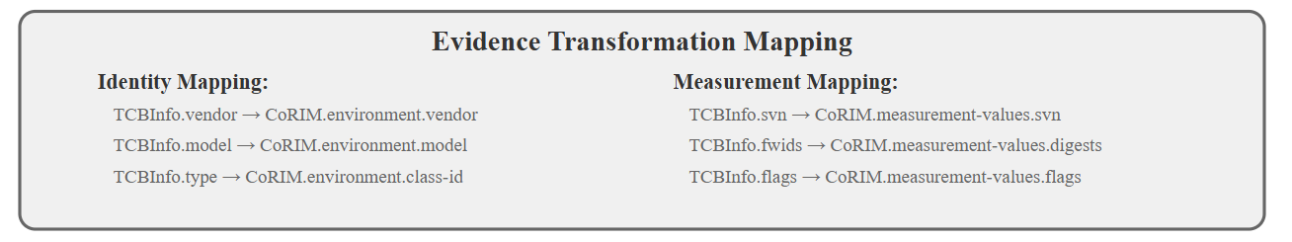
Mapping TCBInfo with Vendor CoRIM

Slide 8
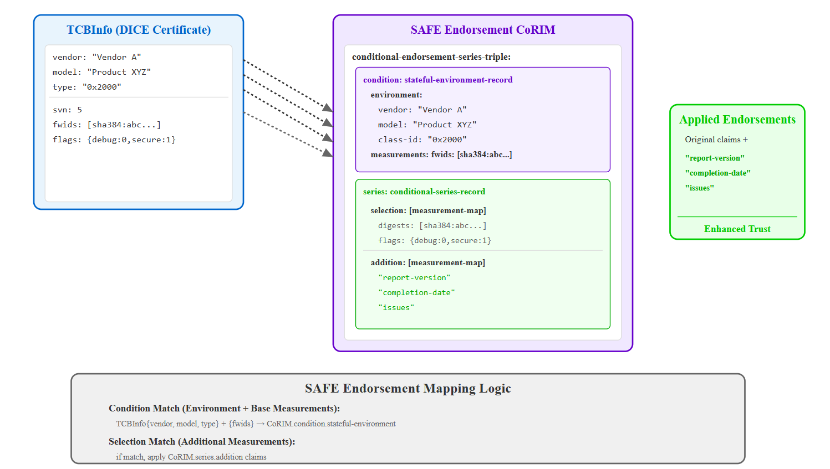
Mapping TCBInfo with CoRIM SAFE

Slide 9
Journey Measurements Claims
Caliptra integrated SoC may support hitless updates.
Journey Measurements records each component firmware state
Journey Measurement = HEM (Journey Measurement -1 | Current Measurement)
*HEM = Hash Extended Measurement
Journey Measurements are reported as IntegrityRegisters[0] in the TCBInfo
TCBInfo
Fwids
Svn
Flags
IntegrityRegisters
Where do I find reference measurement for IntegrityRegisters ?
Verifier

Slide 10
Journey Measurement: Cold Boot
The initial IntegrityRegisters reference value is included as a claim in the CoRIM
CoRIM
(Measurement Map)
TCBInfo
Fwids
Svn
Flags
IntegrityRegisters
Digests
Svn
Flags
IntegrityRegisters
Cold Boot
Claims Match?
Device
Verifier
Reference Value Provider

Slide 11
Journey Measurement: Hitless Update
1. Check if Digests Matches w/ CoRIM Reference Value
CoRIM
(Measurement Map)
TCBInfo
Event Log
Digest A
Svn
Flags
IntegrityRegisters
Fwids
Svn
Flags
IntegrityRegisters
Digest A
Digest B
Digest B
Svn
Flags
IntegrityRegisters
Device
Verifier
Reference Value Provider

Slide 12
Journey Measurement: Hitless Update
2. Calculate Reference Value from Event Log
CoRIM
(Measurement Map)
TCBInfo
Event Log
Digest A
Svn
Flags
IntegrityRegisters
Fwids
Svn
Flags
IntegrityRegisters
Digest A
Digest B
Digest B
Svn
Flags
IntegrityRegisters
RefVal = (0 | A | B)
Device
Verifier
Reference Value Provider

Slide 13
Journey Measurement: Hitless Update
3. Compare Reference Value against Evidence
CoRIM
(Measurement Map)
TCBInfo
Event Log
Digest A
Svn
Flags
IntegrityRegisters
Fwids
Svn
Flags
IntegrityRegisters
Digest A
Digest B
Digest B
Svn
Flags
IntegrityRegisters
RefVal = (0 | A | B)
Device
Verifier
Reference Value Provider

Slide 14
Call To Action
Let’s standardize attestation protocol / formats and improve interoperability
Review the CoRIM Draft and RATS Attestation Architecture
Review the IETF Evidence Transformation Draft
Review the OCP EAT Profile Draft

Slide 15
Backup

Slide 16
Journey Measurement: Hitless Update
CoRIM can`t have a reference value for the IntegrityRegisters after Hitless Update
Appraisal Policy Steps:
The Verifier receives an event-log, which includes the ordered lists of digest updated since cold boot
Component (Vendor, Model, ClassID):
Digest A
Digest B
Digest N
The Verifier corroborates Digests in the event-log against CoRIM(s)
3. The Verifier calculates the Reference Value for the IntegrityRegisters
- RefVal_IntegrityRegisters = SHA384(DigestA | DigestB | DigestB)
4. The Verifier corroborates the calculated Reference Value against the IntegrityRegisters from TCBInfo

Slide 17
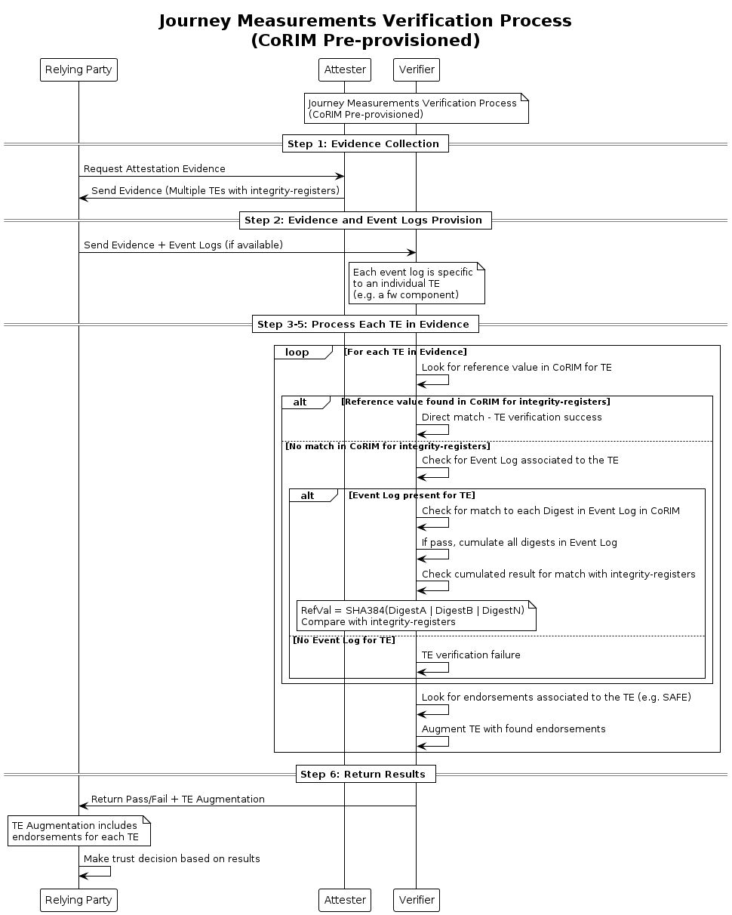
Appraisal Policy of Caliptra TCBInfo
Backup
1. Evidence Collection: Relying Party collects Evidence from the Attester containing multiple Target Environments (TEs)
2. Data Provision: Relying Party provides Evidence and Event Logs (if available) to Verifier, where each event log is specific to an individual TE (e.g., a firmware component)
3. TE Processing: For each TE in the Evidence, the verifier looks for a reference value in the CoRIM
4. Integrity-Registers Verification: For the "integrity-registers" claim, if there's no match in CoRIM, the verifier:
Checks for an Event Log associated to the TE
If present, checks for a match to each Digest in the Event Log in CoRIM
If pass, cumulates all digests in the Event Log and checks for match with integrity-registers
5. Endorsement Processing: The Verifier looks for any endorsement associated to the TE (e.g., SAFE) and augments each TE with the
6. Endorsement
Result Return: Return Pass/Fail and TE Augmentation to Relying Party

